Slide 1
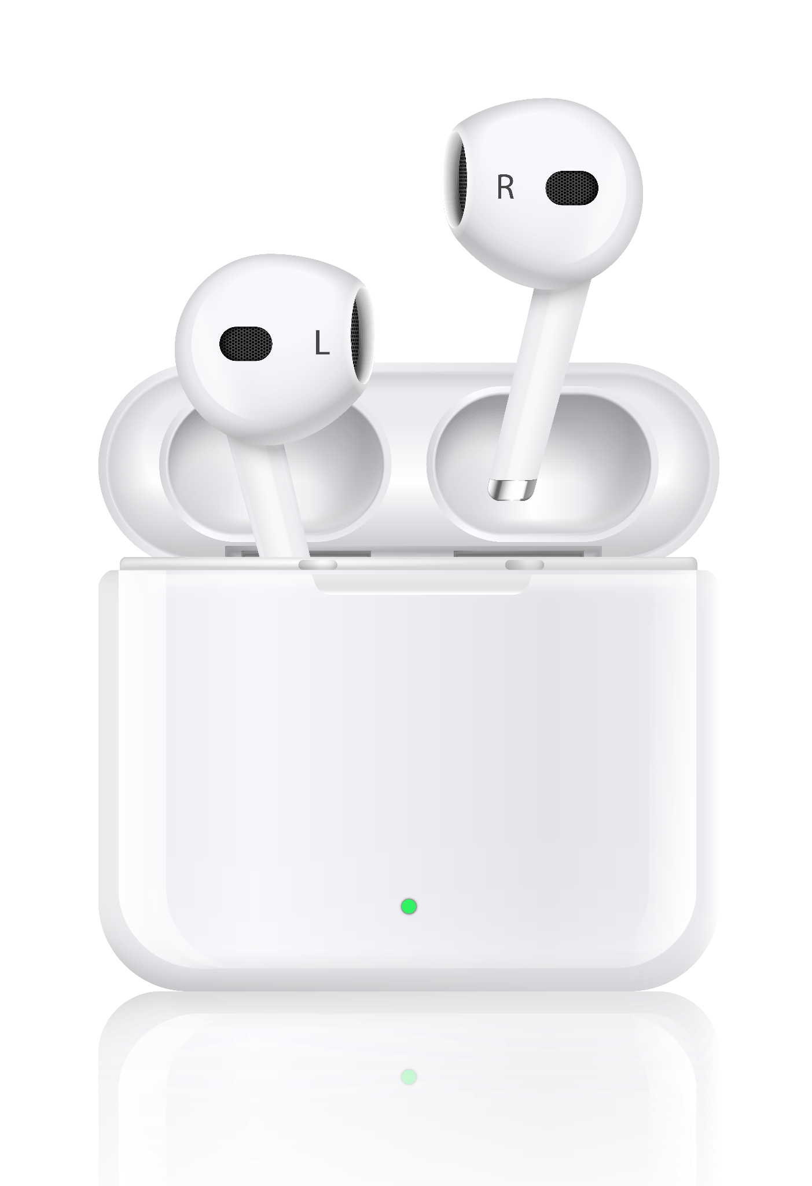


Apple Airpods
Feedback Analysis

Slide 2
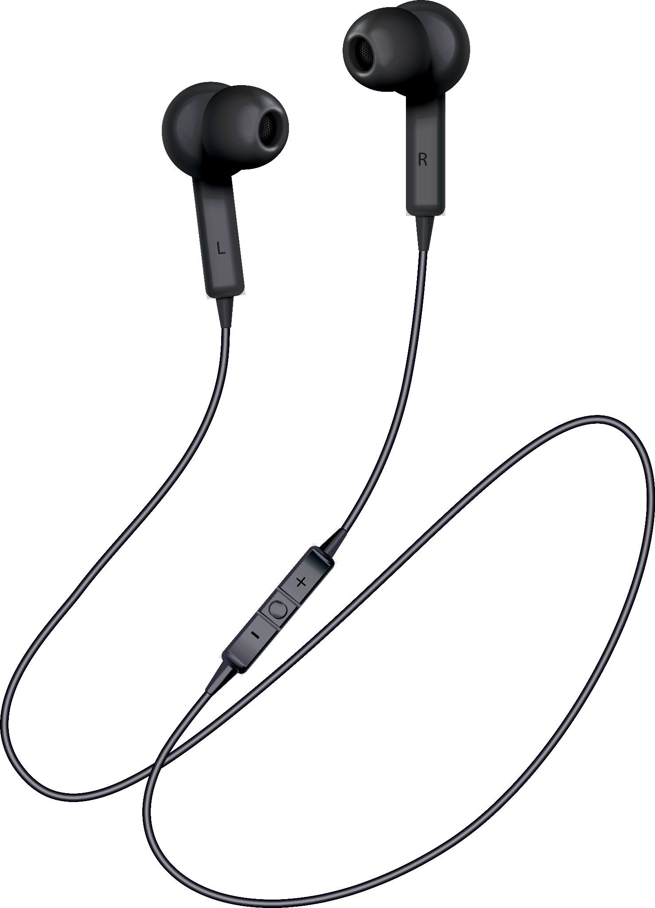
Table of contents
01
02
04
05
03
Problem Statement
Data
Extraction
Data
Cleaning
NLP Analysis using TextBLOB
06
07
NLP Analysis using VADER
Word Cloud for each Airpods
Clustering

Slide 3
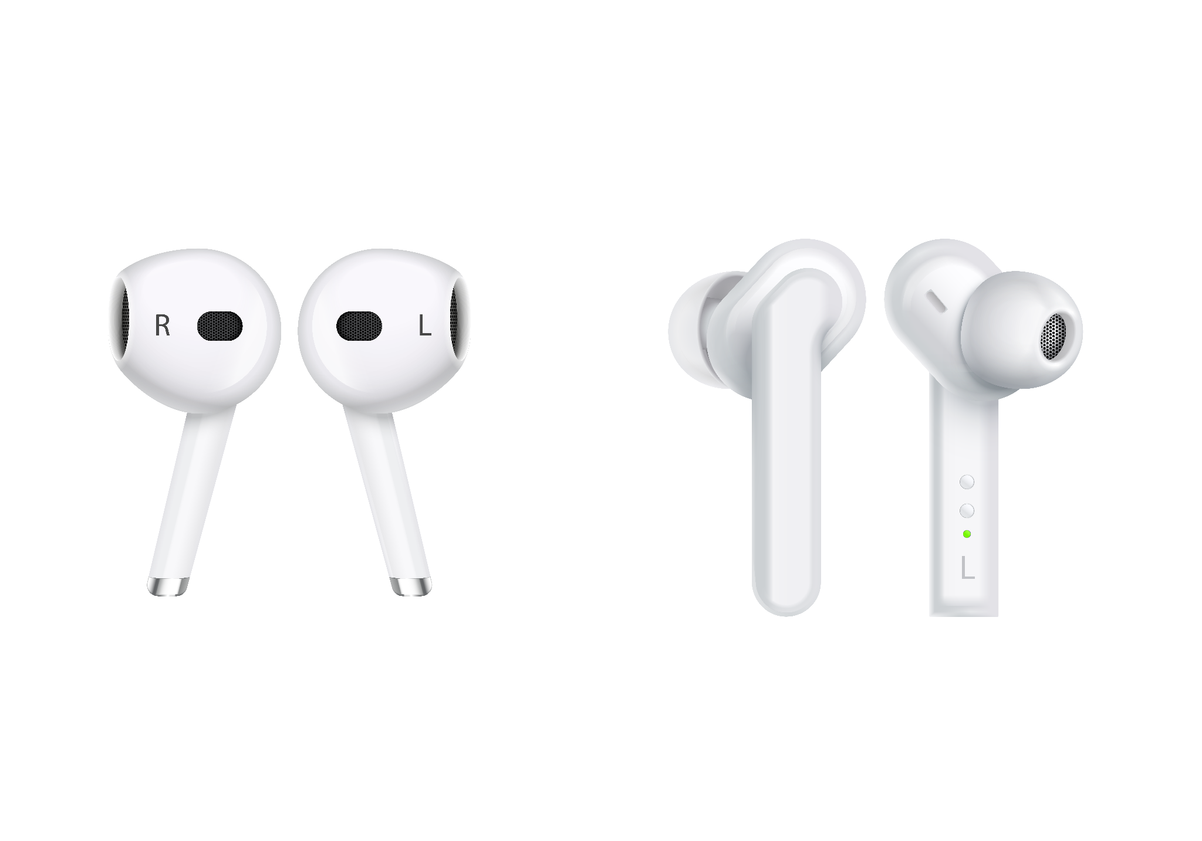

Airpods
Apple's AirPods are a series of wireless earbuds designed to offer high-quality audio, seamless connectivity, and an immersive user experience. Launched in 2016, AirPods have become a market leader in the wireless audio category, with several iterations introduced over the years to enhance functionality and user satisfaction.

Slide 4


Key Features of AirPods
Wireless Freedom.
High-Quality Audio.
Integrated Ecosystem.
Long Battery Life.
AirPods Variants
AirPods (1st–4th Generation):
AirPods Pro (1st–3rd Generation):.
AirPods Max

Slide 5

—Heraclitus
“Each coin has two sides.”

Slide 6
Problem statement
AirPods, as one of Apple’s flagship products, have garnered significant attention and user feedback on Apple’s discussion forums. While AirPods are known for their innovative features, users often face issues that impact their experience. However, the diversity and volume of feedback make it challenging to identify recurring problems and prioritize solutions effectively.
Objective
To analyze and categorize user feedback on AirPods from Apple Discussion forums using Natural Language Processing (NLP) techniques to identify major issues. This will help uncover patterns, prioritize customer pain points, and propose actionable solutions for improving the product and user satisfaction.

Slide 7
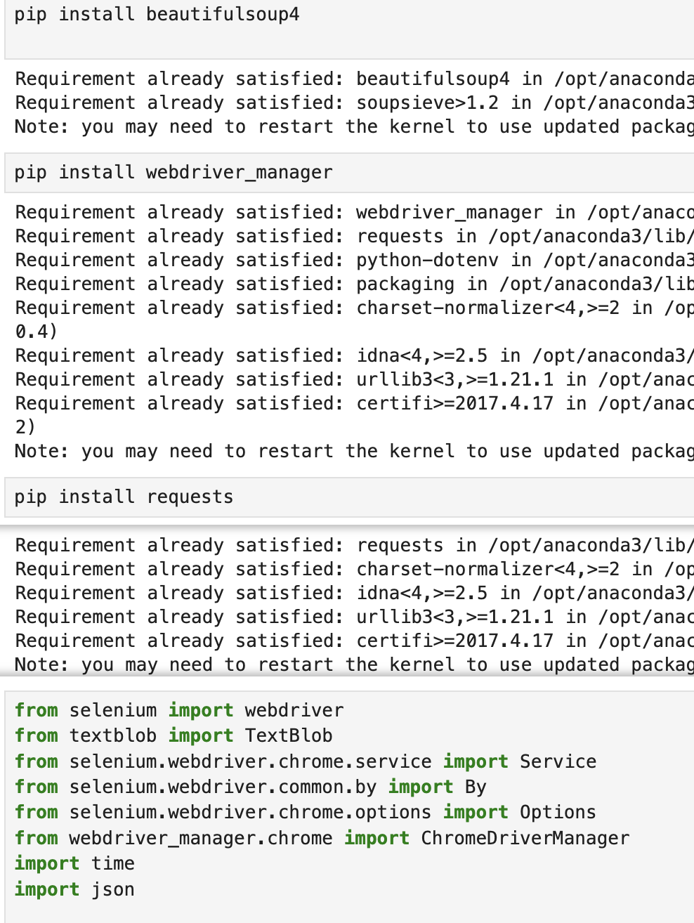



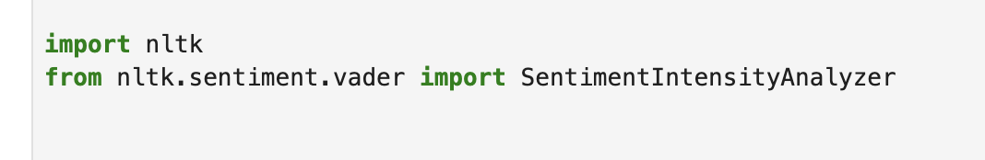

Installation of necessary library

Slide 8
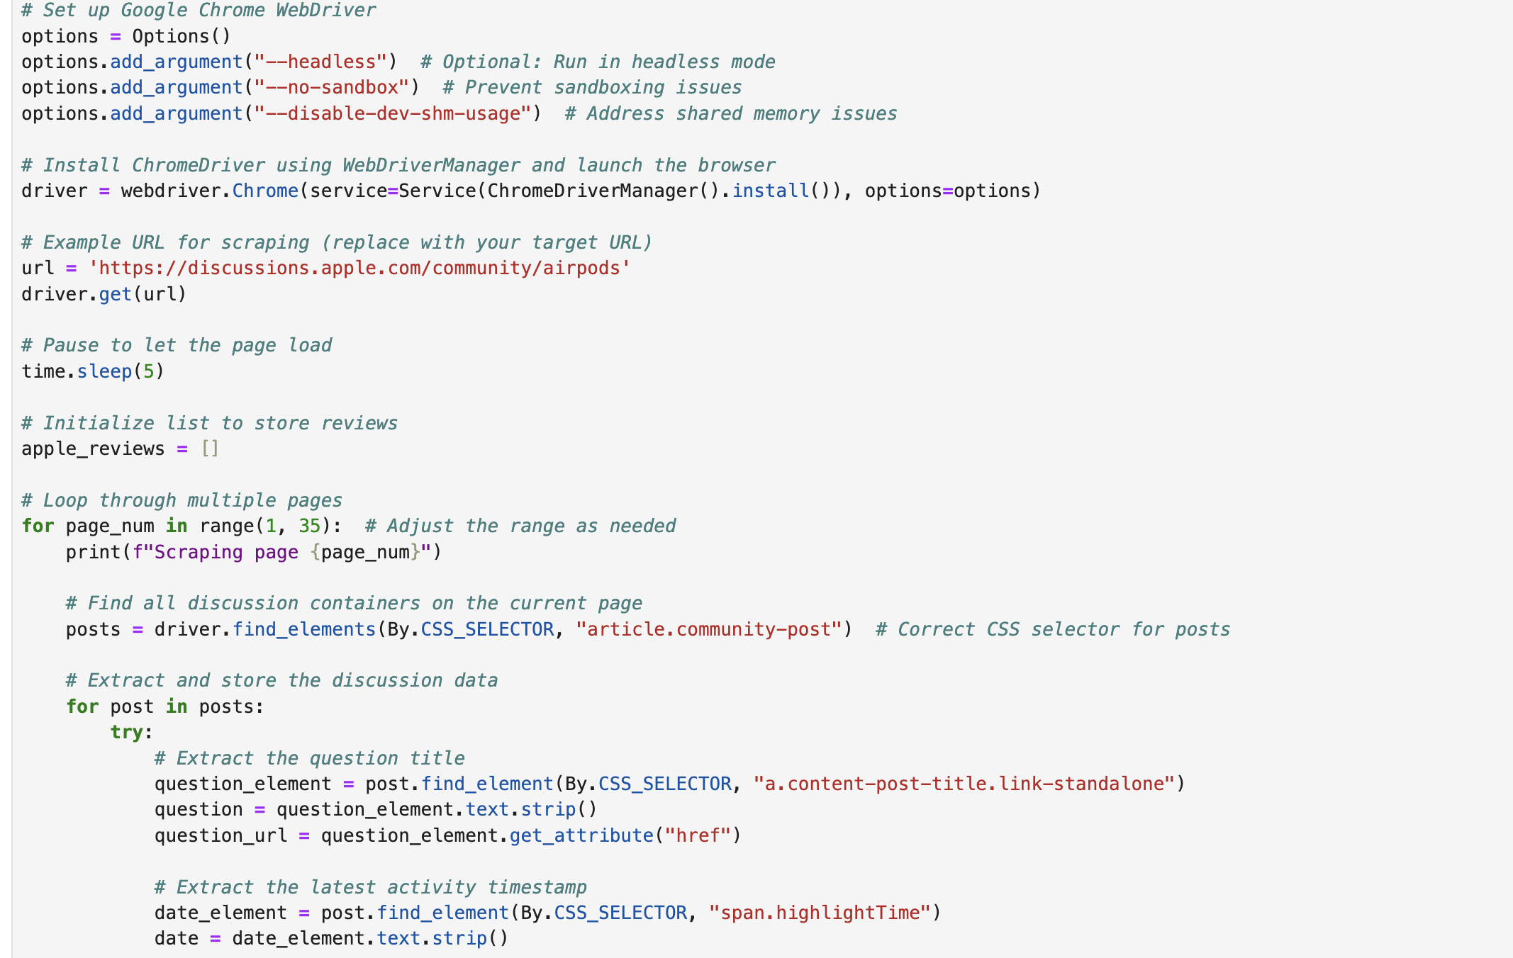
Web Scrapping
Using Selenium & BeautifulSoup

Slide 9
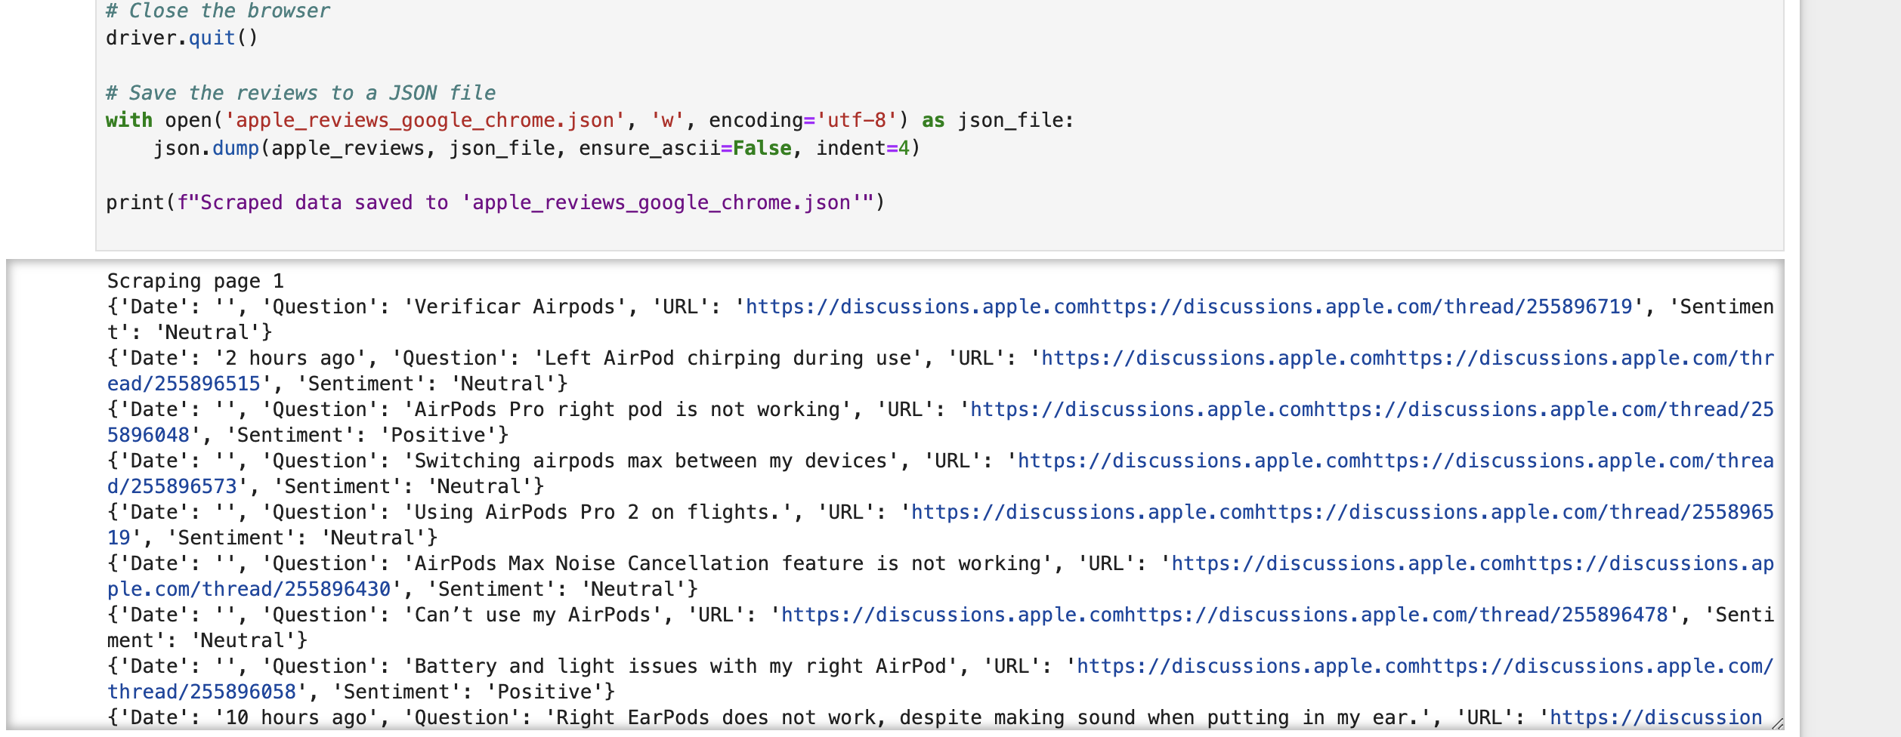

Slide 10
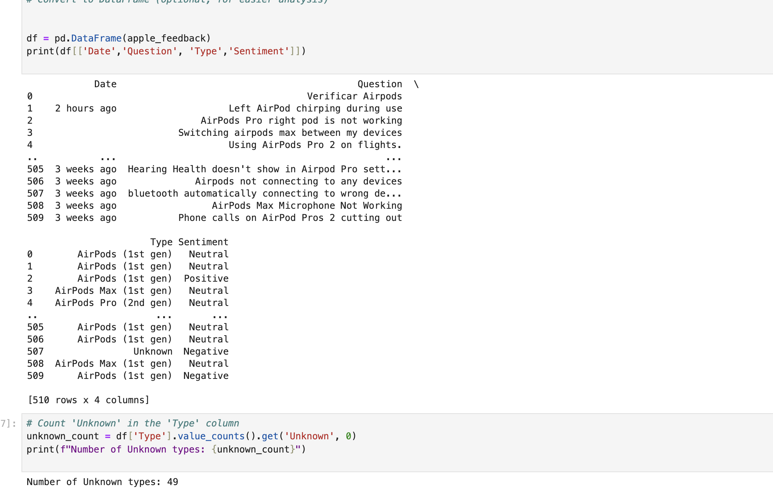
Data Cleaning

Slide 11
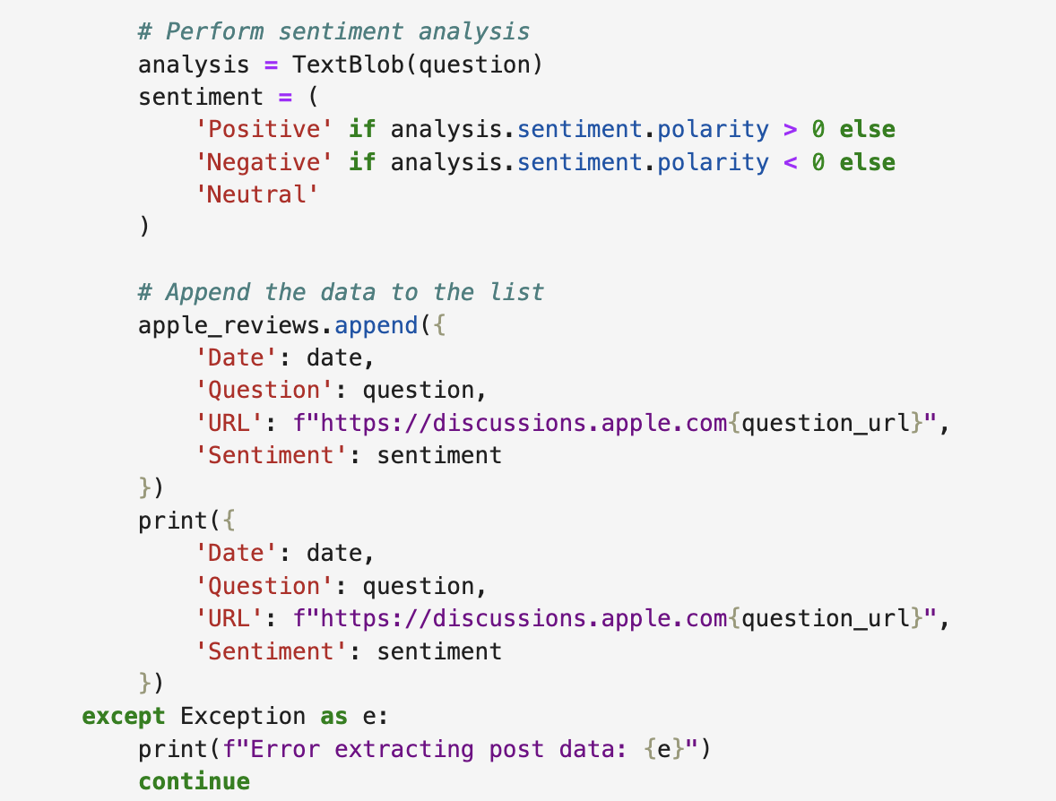
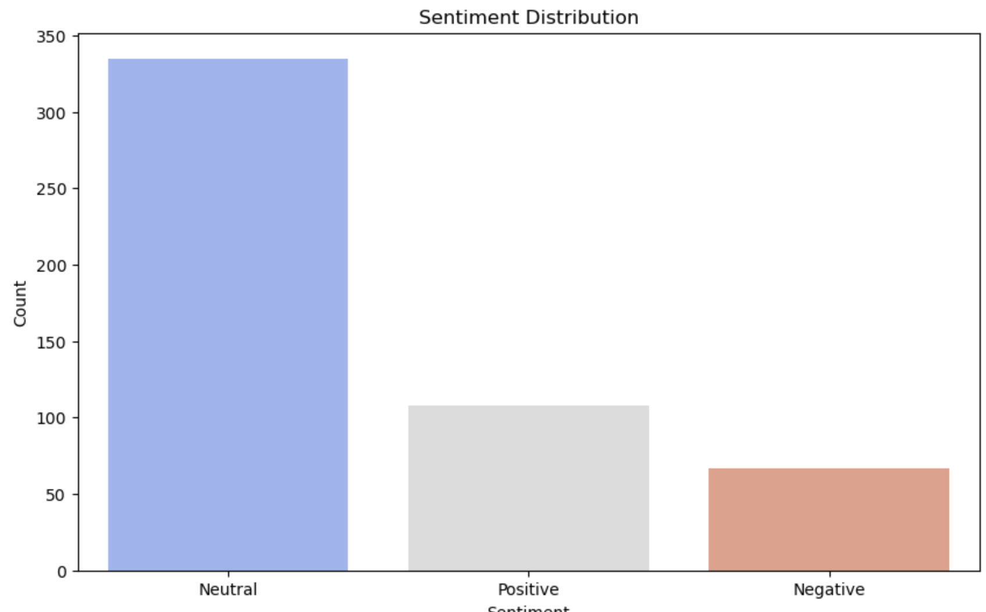
NLP Analysis using TextBLOB

Slide 12
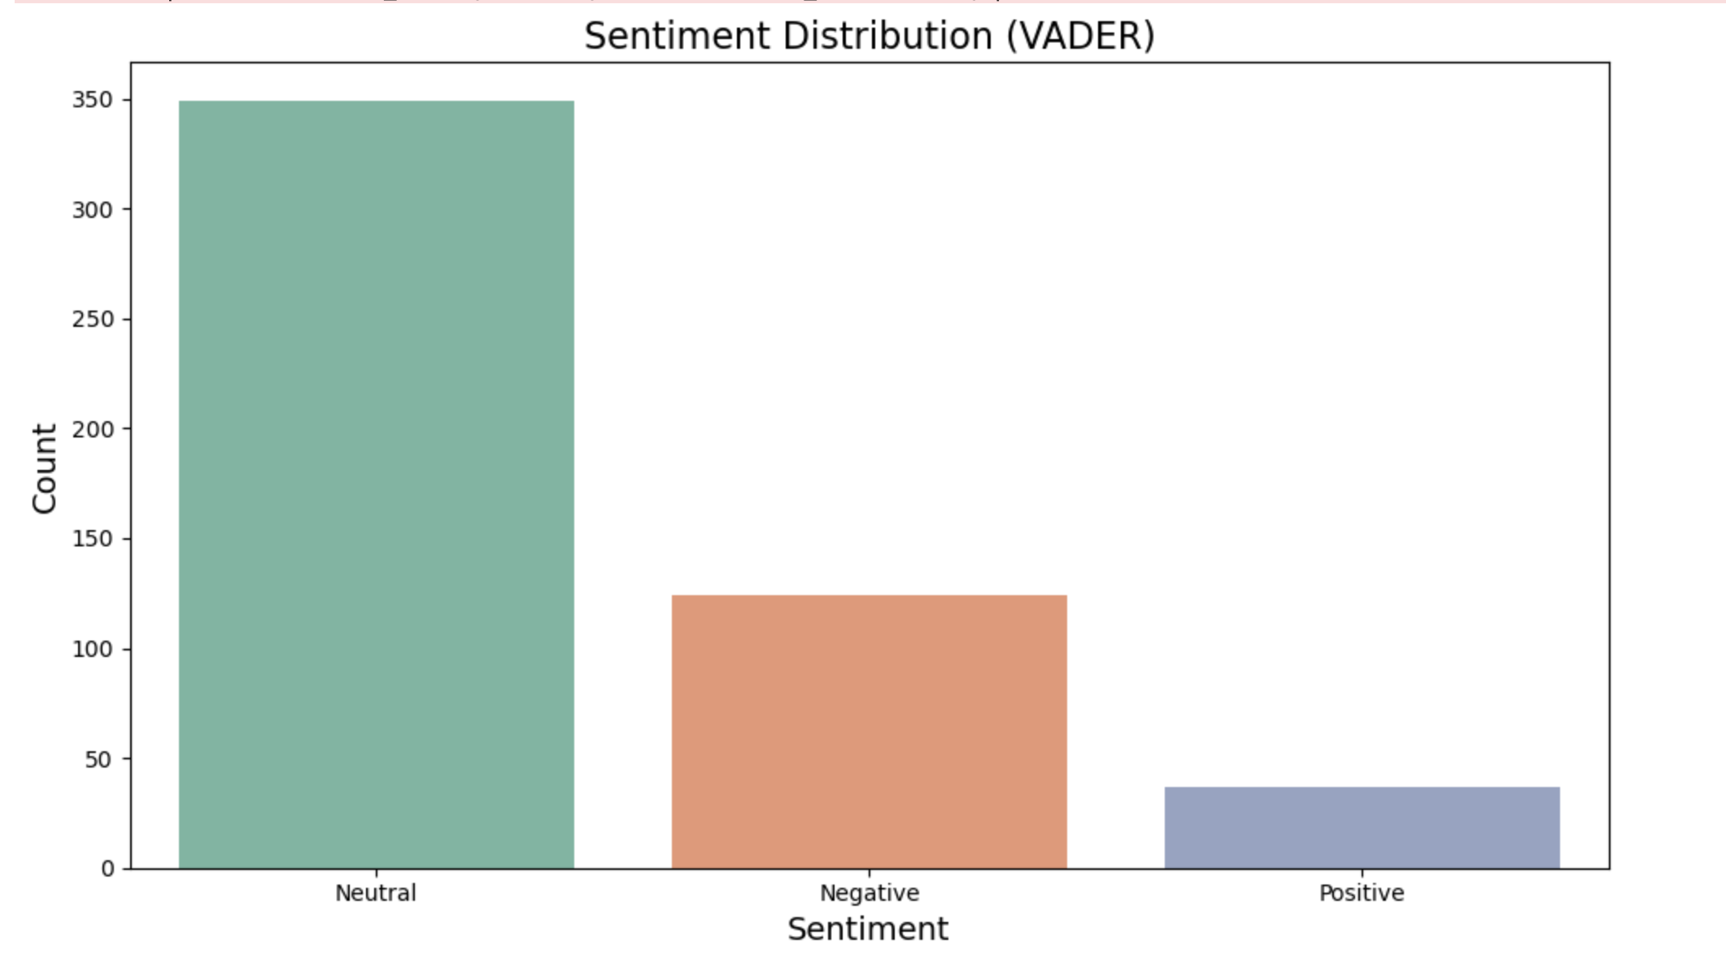
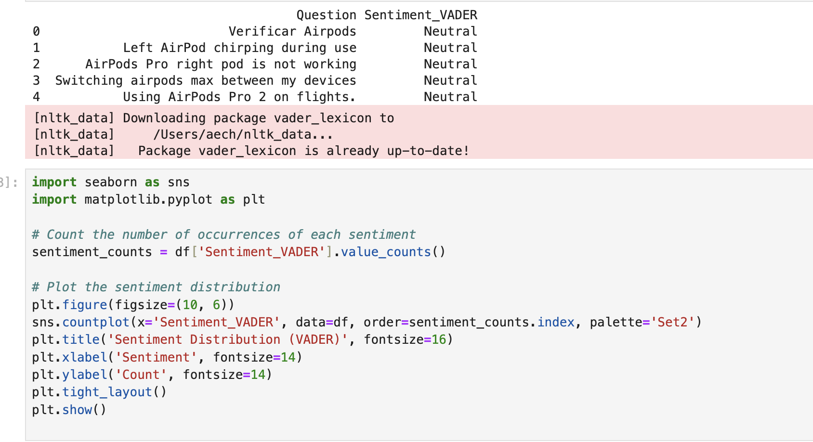
NLP Analysis using VADER

Slide 13
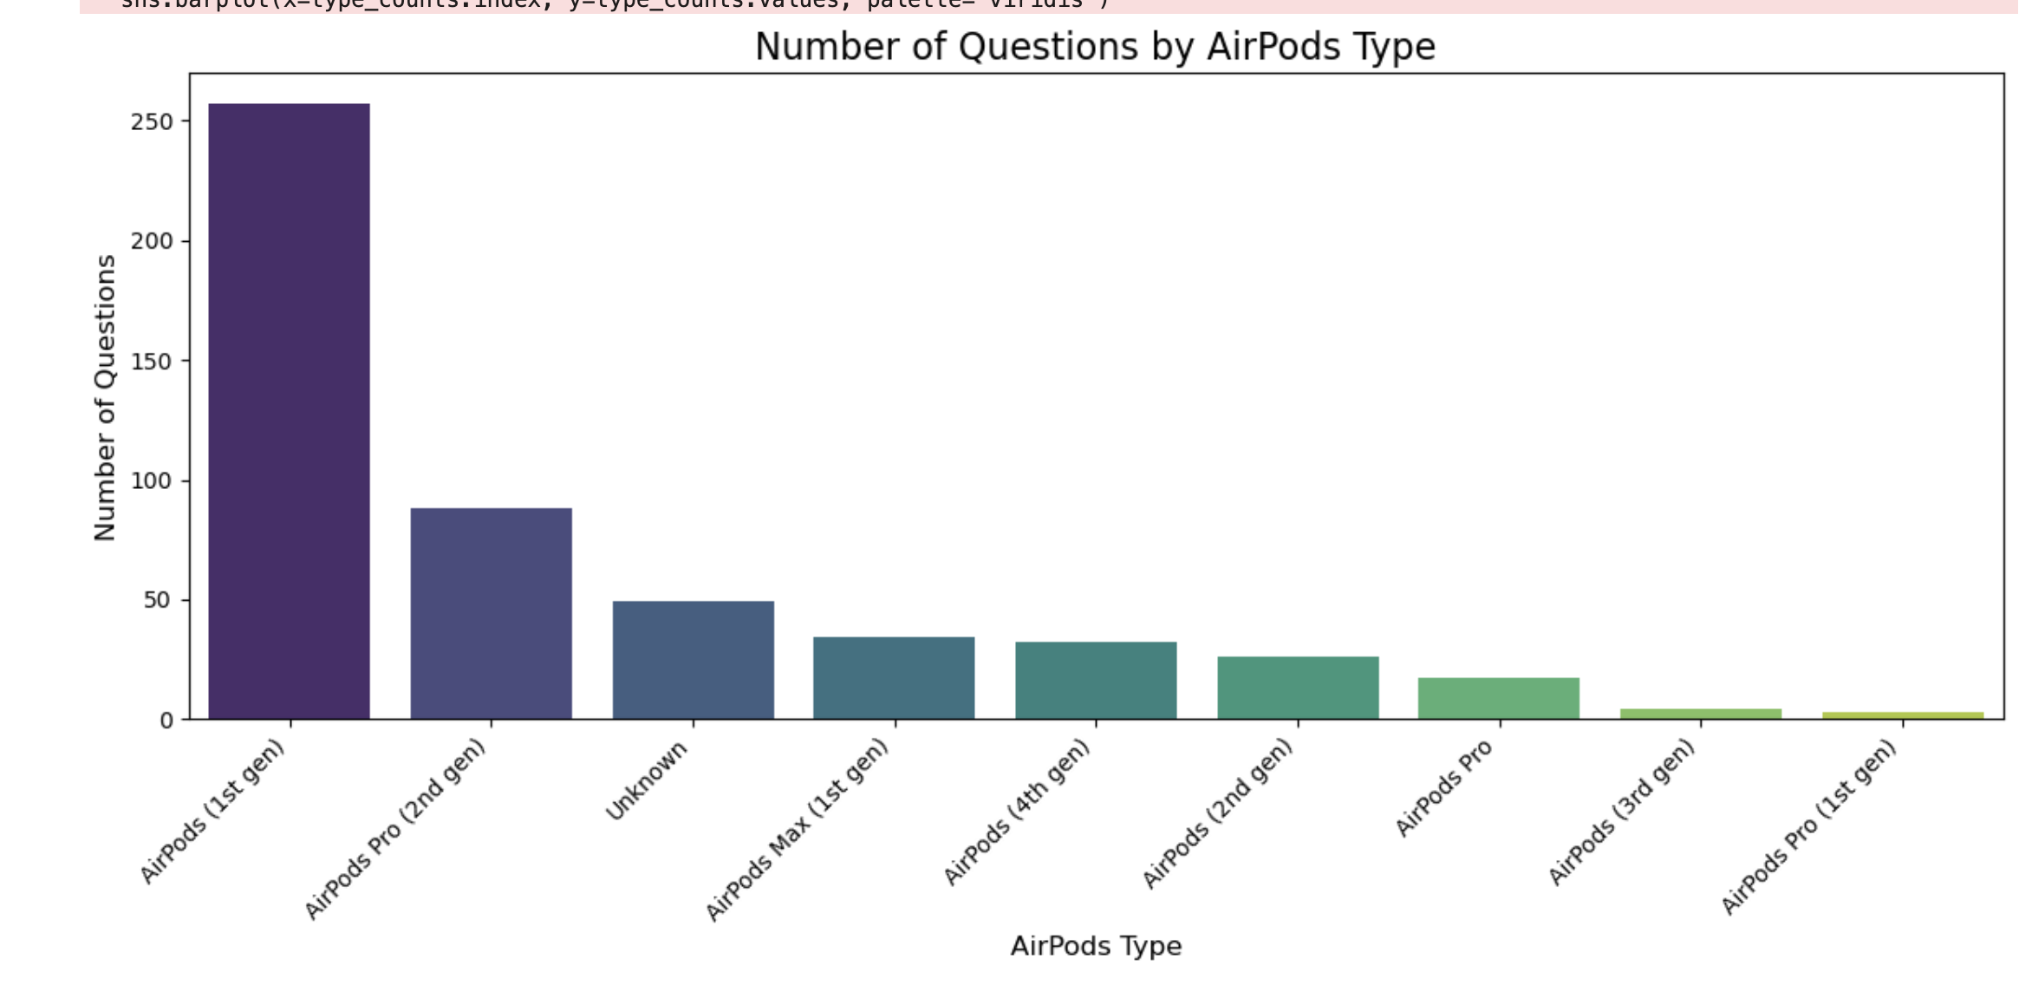

Slide 14
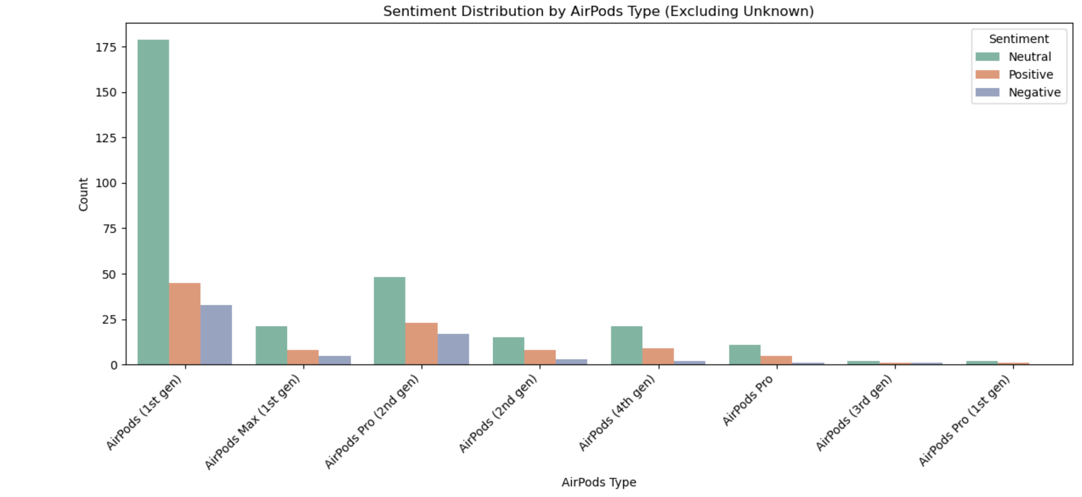

Slide 15
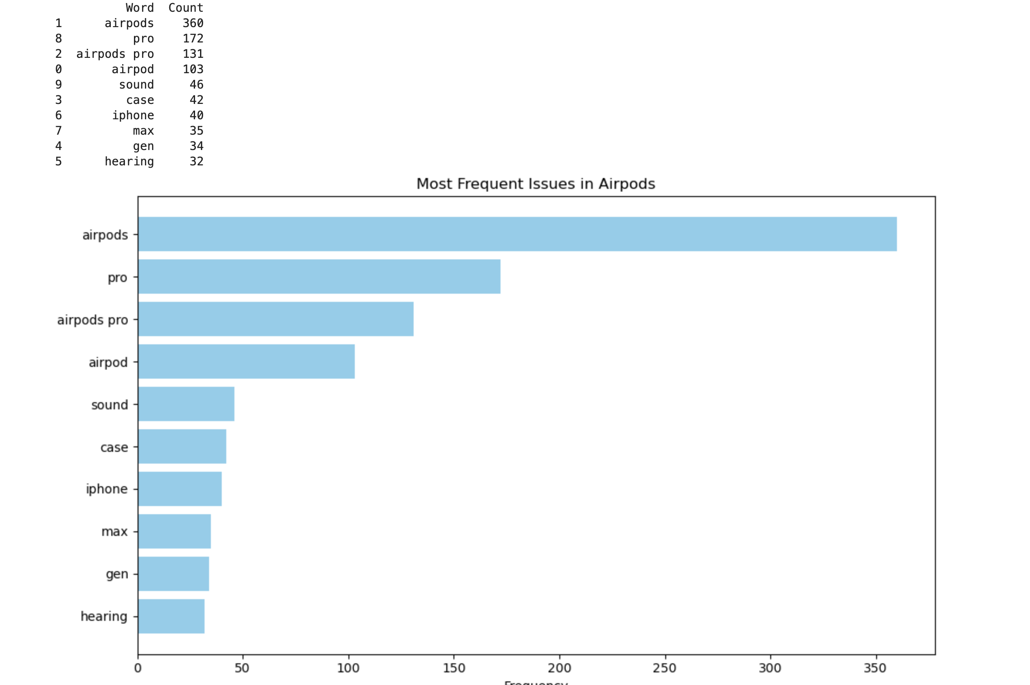

Slide 16
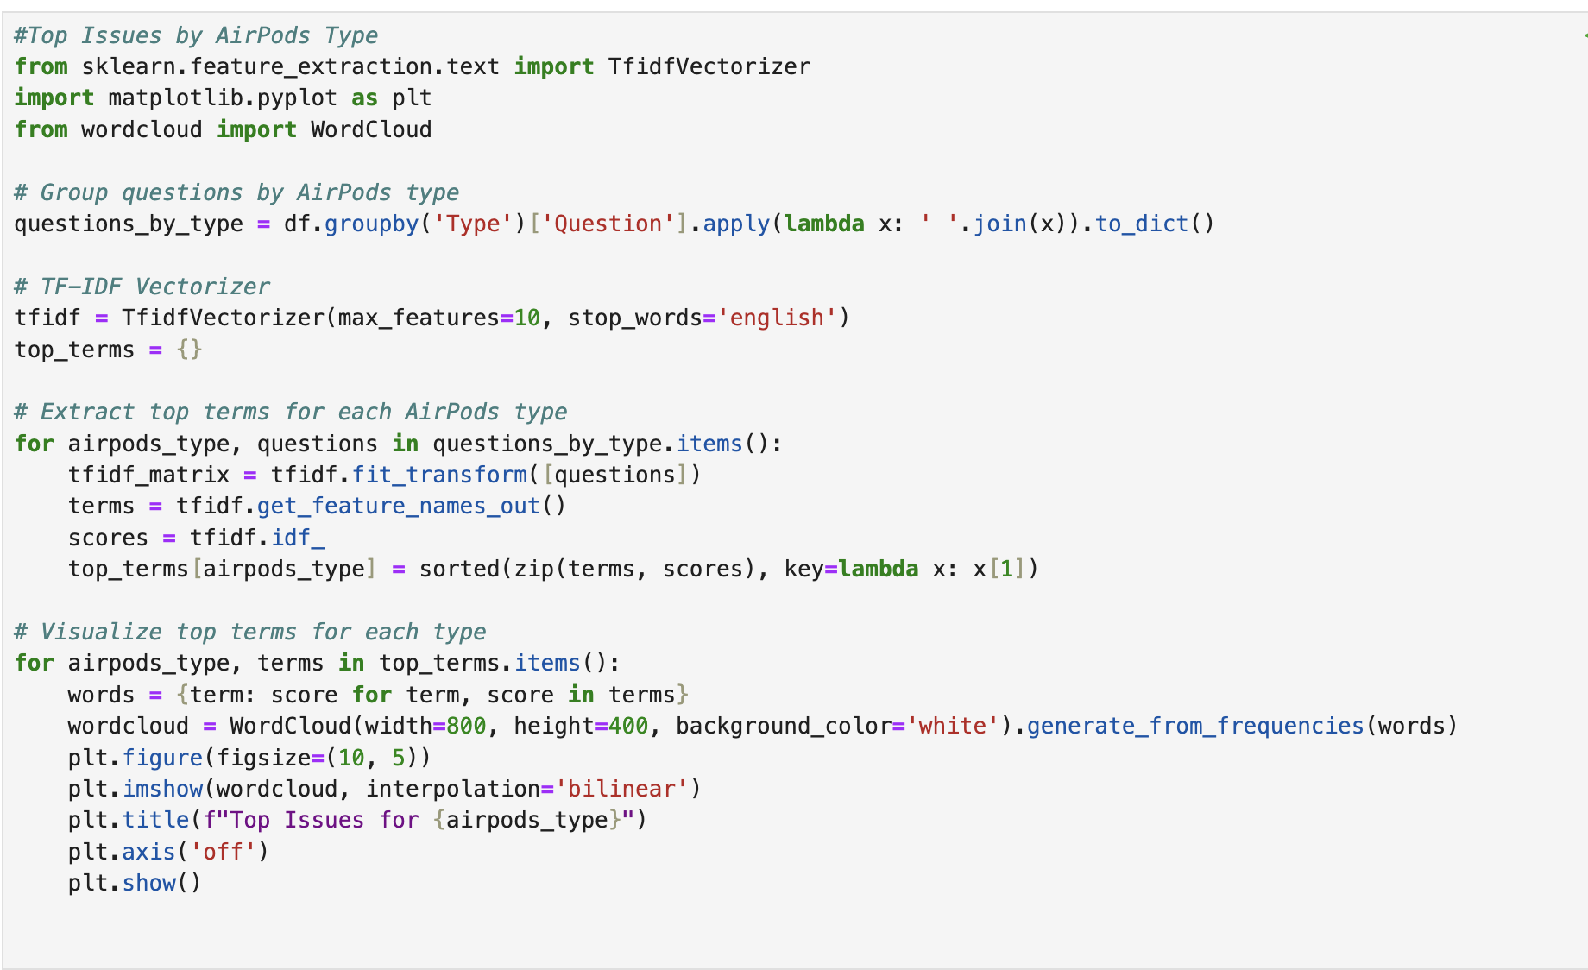
Word Cloud for each Airpods

Slide 17
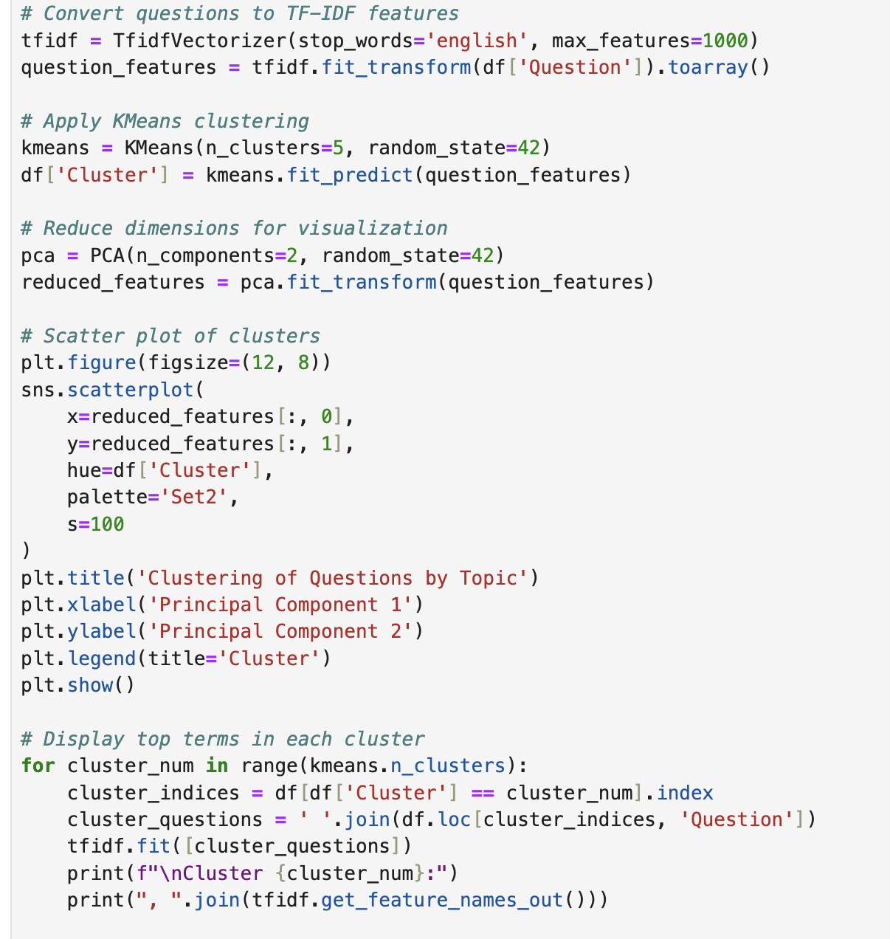
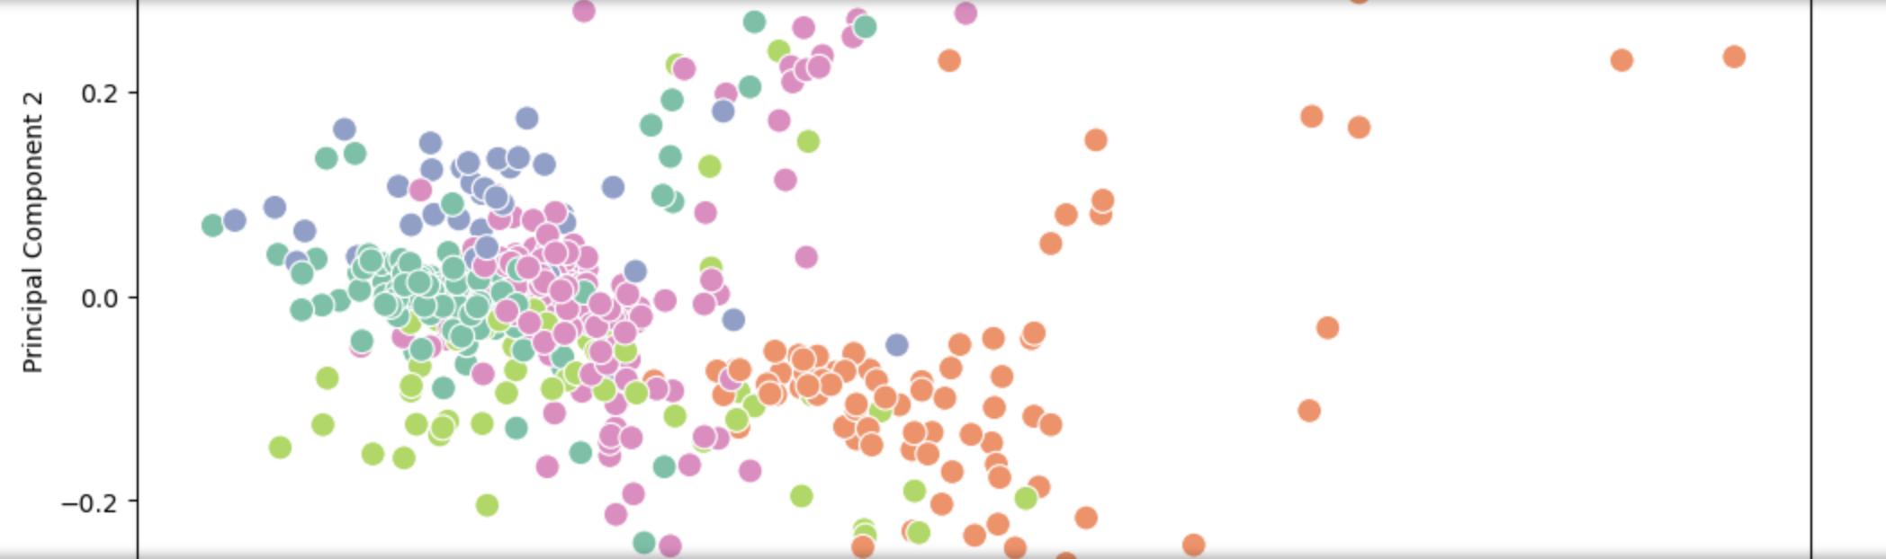

Clustering

Slide 18
THANK YOU

